Slide 1
Testicular tumor
Dr Bhupendra P. Singh
MCh(Urology), FRCS(Edin), DNB, MS
Associate Professor, Urology
King George’s Medical University
Lucknow

Slide 2
A 17 yrs male presents with heaviness in Rt. Scrotum for 3 months, without a definite h/o testicular trauma.
O/E: painless enlargement of Rt testes with a palpable intraabdominal mass in paraumblical region.
What is your clinical Diagnosis ?

Slide 3
Painless solid testicular swelling in male
Is testicular tumor unless proven otherwise.
Between 15 -34 yrs age most common.
Increased risk in undescended testes.
May have secondary hydrocele : lax & -ve transillumination
Examine : abdomen and supraclvicular LN, lung/liver/bones
DDx : calcified hydrocele / organised hematocele

Slide 4
Clinical presentation
Age :
- most common solid tumor in young men b/w 20 -35 years age
- smaller peak in men > 60
Painless testicular enlargement, Heaviness/dull ache in few
History of testicular trauma – purely incidental
Gynaecomastia : in ledig cell tumor

Slide 5
Natural History of disease
Intratubular germ cell neoplasia in situ (CIS) – confined by BM of seminiferous tubules → 50% CiS progress to Invasive tumor
Lymphatic spread before vascular invasion except ChorioCa
- First LN on Lt side is Para-Aortic
- First LN on Rt side is Inter-AortoCaval
- Rt to Lt spread Yes, but not from Lt to Rt (implication in RPLND)
around & above Umblicus

Slide 6
Natural History of disease
- Mediastinal LNs → Supraclav. LNs (Lt side:Virchow’s node)
- Lower Para-aortic & iliac LNs spread : Retrograde spread
due to blockage of higher LNs/ aberrent lymphatics
- Inguinal LNs : due to Local spread / scrotal violation
Blood borne metastasis to – lung, liver & bone
Vascular invasion is more in ChorioCA – Lung most common

Slide 7
Testicular tumor & Undescended testes (UDT) :
Cause : germinal dysplasia and genetic changes
8 X increased risk (5-15 times) of testicular malignancy
8-9 % tumors have prior h/o undescended testis (7-12%)
Increased risk in normal contralateral testis also
8% will develop tumor in normal contralateral testis if there occurred a tumor in undescended testis

Slide 8
Testicular tumor &
Undescended testes (UDT) :
Lower abdominal / groin mass with empty ipsilateral scrotum
Age of tumor present. : same as in normally descended testis.
Most common tumor : seminoma.
Both UDT and testicular tumor slightly more on Right side.
Higher the testis in location, higher is the risk.
Malignancy risk isn’t decreased by bringing down the testis .

Slide 9
Testicular tumor &
Undescended testes (UDT) :
Tumor risk till Middle age only so :
→ Councel UDT repair patients for regular self palpation of testis till middle age : for early tumor detection
→ If a UDT Patient presents after 40 yrs age : no need to remove UDT testis for tumor risk

Slide 10
Classification : histological
1. Germinal Cell Tumors (GCTs):
Seminoma : 35-40% of total testicular tumors
Non seminomatous Germ Cell Tumors (NSGCT) : group
- Yolk Sac Tumor
- Teratoma:
(Ecto/endo/meso dermal & +/- mailgn. Transformation)
- mature
- Immature
- malignant non-germ cell
- Embryonal Carcinoma
- Choriocarcinoma
- Mixed Germ cell tumor

Slide 11
Classification : histological
2. Non - germinal tumors :
Specialized gonadal stromal tumors :
- Ledig cell tumors
- Sertoli cell tumors
- Gonadoblastoma
Carcinoids
Adrenal Rests
Mesenchymal Tumors

Slide 12
Seminoma
85% are pure/classic seminoma: No specific tumor marker
- LDH is used as marker for tumor bulk assessment and
treatment response
15% have some syncytiotrophic component: some b-HCG secretion
Higher S. Alpha feto-protein excludes diagnosis of seminoma

Slide 13
Seminoma
Less aggressive than NSGCT :
- 2/3 to 3/4 patients present in stage 1
- No poor risk categeory in IGCC classification based on
level of TMs , Primay mediastinal tumor & Non Pulmonary
Viceral mets
Highly Radiosensitive: RT can cure LNs upto 5 cm
Highly Chemosensitive tumor : can be curative in stage IV

Slide 14
Seminoma : special types
Anaplastic :
- 10 % of seminomas, accounts for 30% deaths due to seminoma
- High mitotic activity/faster spread : presents in advanced stage
- Stage to stage prognosis is equal to typical seminoma
Spermatocytic seminoma : 1-2% of seminomas, elderly male
- Best prognosis of all testicular tumors
- No metastasis reported, so Radical orchiectomy is an enough Tt

Slide 15
NSGCTs
A Group of variuos histologies:
- usually Mixed germ cell tumor
Yolk sac tumor/ endodermal sinus tumor:
- is the most common testicular tumor in children
Teratoma ( +/- malignant transformation):
- second most common testicular tumor in children

Slide 16
NSGCTs
Younger age of presentation than seminoma (by5 yrs)
More aggressive than Seminoma :
- 2/3 present with nodal (stage 2 ) or higher disease
Highly Chemosensitive : can be curative in stage IV
Surgery sensitive tumor : RPLND can cure LNs upto 5 cm
No role of Radiotherapy

Slide 17
Other Tumors
Ledig cell tumors : 1% of total , 10% malignant
- Gynaecomastia, Reinke crystals
- never malignant in prepubertal boys
- histology cannot diagnose malignancy so labelled
malignant only when metastasis is seen
Sertoli cell tumors : < 1%, 10% malignant
- malignancy is diagnosed by metastasis

Slide 18
Tumor markers
HCG : comes from SynCytiotrophoblasts, elevated in :
- in all Choriocarcinomas
- 50% of embryonal carcinomas
- 5-10% of pure seminomas
levels in male : < 1 ng/ml ( 10 mIU/ml)
half life : 24 Hr ( of beta subunit – 1 Hr )

Slide 19
Tumor markers
Alpha – fetoprotein : by Yolk Sac, it’s presence rules out :
- Pure Seminoma &
- Pure horiocarcinoma
- Half life(T1/2) : 5-7 days
LDH : marker of bulk of disease, is used to monitor :
- Advanced Seminoma
- Marker Negative NSGCT

Slide 20
Investigations

Slide 21
Investigations
USG scrotum : if doubt in Dx for confirmation
Tumor markers : alfa fetoprotein, B- HCG, LDH
Chest Xray : for metastasis , LFTs
CECT scan abdomen for RP-LNs , if +nt → do CT chest also in same sitting

Slide 22
Staging

Slide 23
Staging
Clinical :
Boden & Gibb
A(1)- Confined to testes only
B(2)- Retroperitoneal LNs
C(3)- Extranodal disease
Skinner subdivided stage 2 into three subdivisions:
1 – testes only
2A- retroperitoneal LNs seen on imaging only
2B – Palpable LN mass
3 – supradiaphragmatic/medistinal/cervical LNs
4- Viceral mets

Slide 24
Staging
AJCC : TNMS staging
TNM + Risk groups according to TM levels ( Sx, S0, S1, S2 , S3)
IGCC risk groups : based on 1) TM 2) testicular / retroperitoneal vs Mediatinal primary 3) Nonpulmonary viceral Mets :
Seminoma – good and intermediate risk groups only
NSGCT – good , Intermediate and poor Risk groups

Slide 27
Stage grouping
 | T | N | M | S
Stage 0 | pTis | N0 | M0 | S0
Stage 1 | T1-4 | N0 | Mo | S0
Stage Is | Any T | N0 | M0 | S1-3
Stage 2a | Any T | N1 | M0 | S0-1
2b | Any T | N2 | M0 | S0-1
2c | Any T | N3 | M0 | S0-1
Stage 3a | Any T | Any N | M1 | S0-1
3b | Any T | Any N | M1 | S2
3c | Any T | Any N | M1 | S3

Slide 28
AJCC TNMS
Subdivides stage I disease into stages Ia and Ib depending on the T stage, as well as into stage Is according to serum tumor marker levels.
Stage II is subdivided into stages IIa, IIb, and IIc depending on volume of retroperitoneal lymph node involvement.

Slide 29
Stage III is subdivided into stages IIIa, IIIb, and IIIc according to the degree of metastatic involvement and serum tumor marker levels.

Slide 30
Treatment of Testicular Tumor

Slide 31
Multimodal approach
Surgery
Chemotherapy
Radiotherapy

Slide 32
Initial Management in all
Don’t do FNAC / don’t give incision on scrotum
High inguinal ochiectomy (Radical orchiectomy ):
- to avoid local tissue violation
- to get the most proximal lymphatics

Slide 33
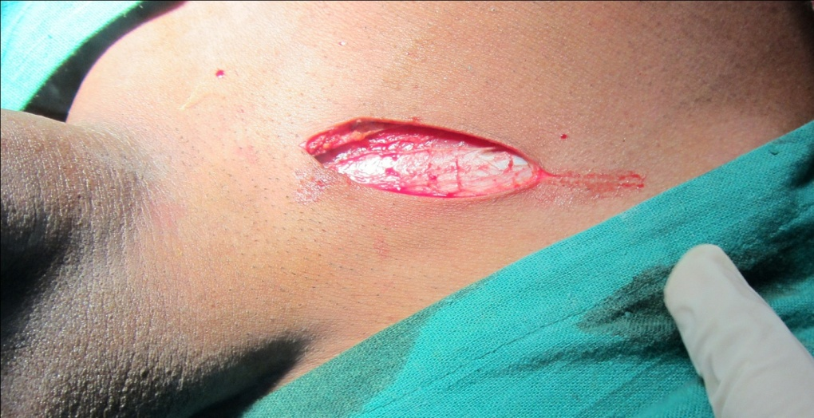
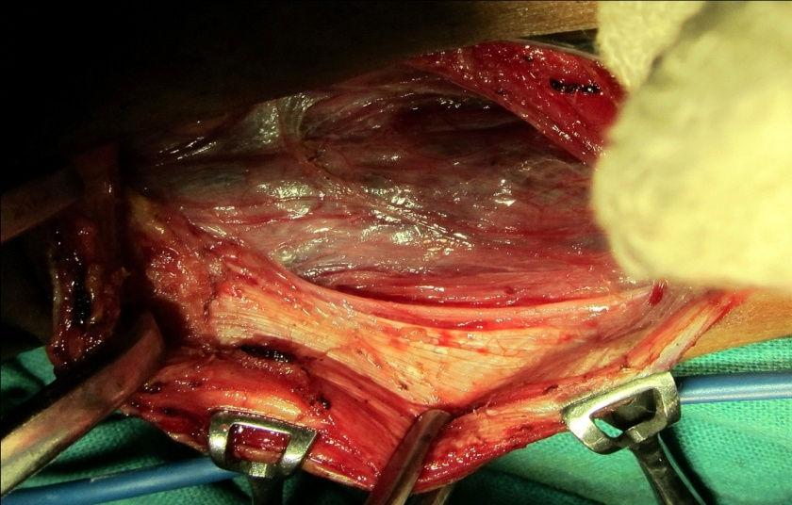
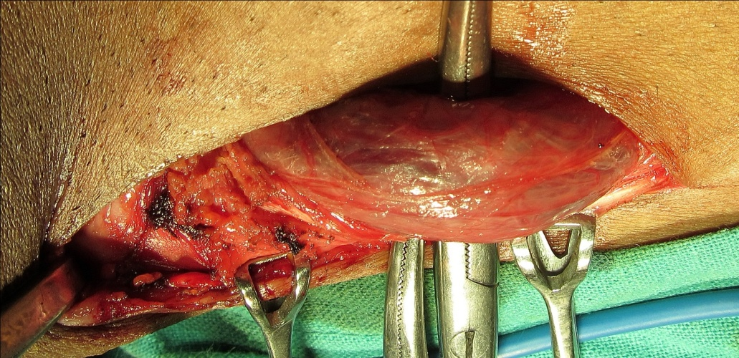
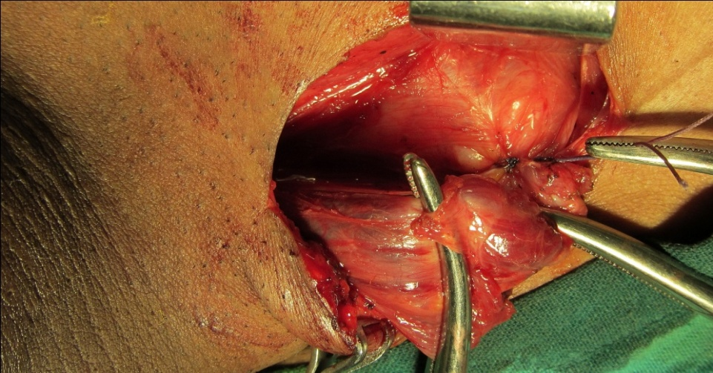
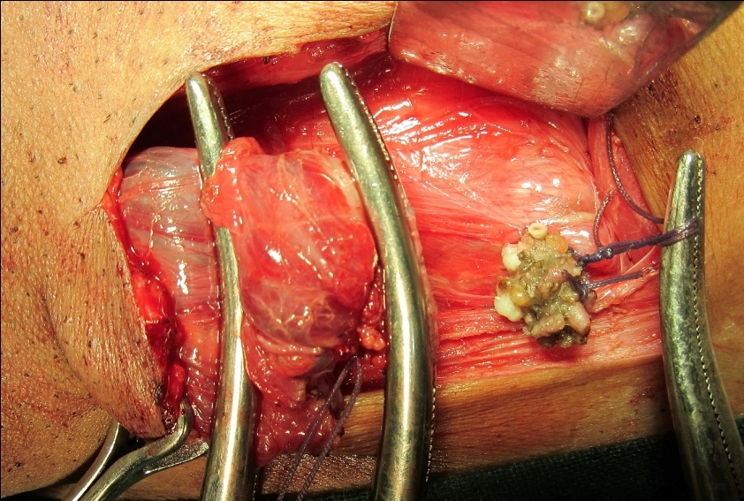
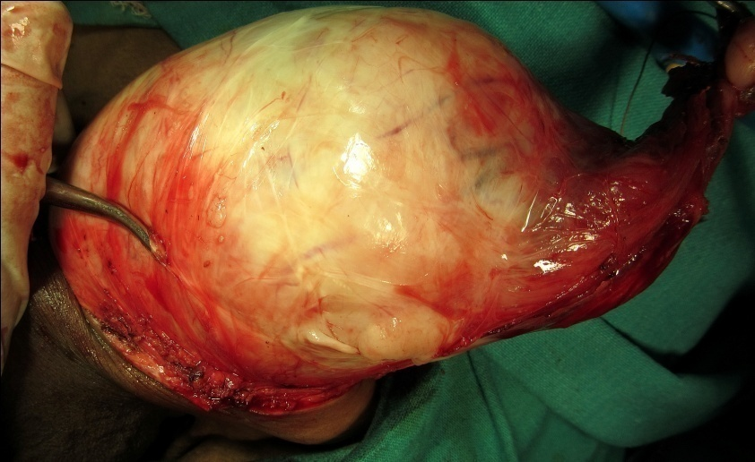

Slide 34
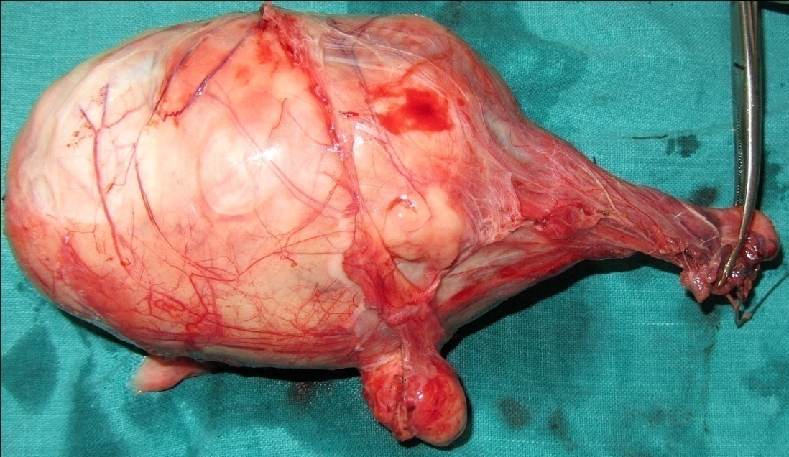
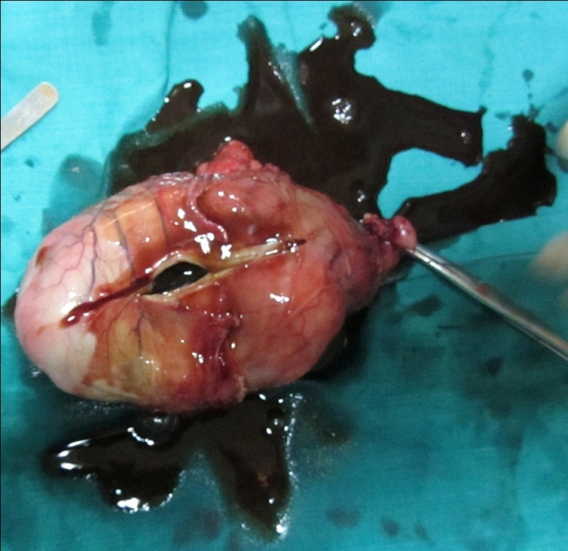
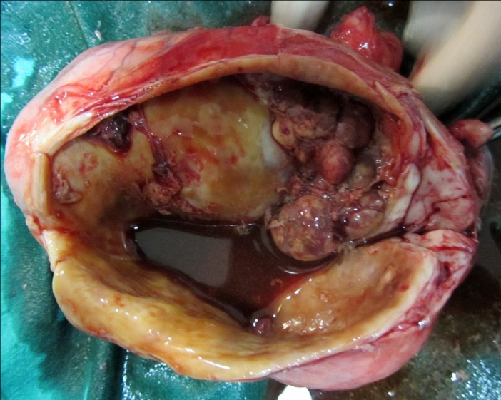
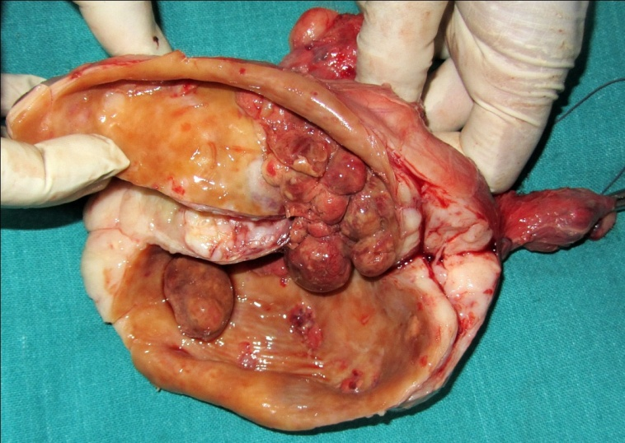
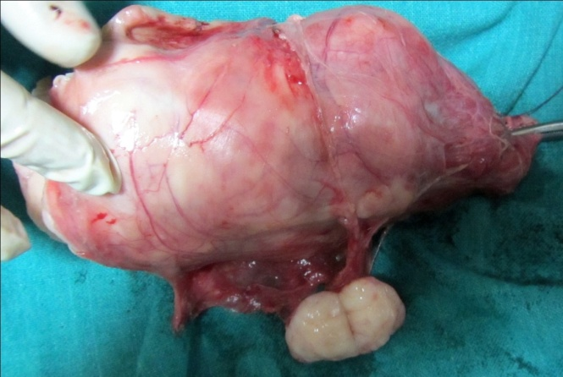

Slide 35
Role of Radical Orchiectomy
Diagnostic : Histology & Local Staging
Therapeutic :
Decreasing the tumor burden
A sufficient treatment ( curative ) in :
- CIS
- Spermatocytic seminoma
- Typical seminoma – if low risk & stage 1 ( smaller tumor,
no vascular & rete testis invasion ) with close surveillance

Slide 36
Principals of LN management
Seminoma : early stages can respond to RT- highly radiosensitive tumor , Late stage – Chemotherapy
NSGCT : surgery ( RPLND) in early stage, in late stage chemotherapy is mainstay of Tt – monitor by imaging and tumor markers
Postchemotherapy residual LNs :
NSGCT – RPLND,
Seminoma - if <3cm and no hot spot on PET – can observe

Slide 37
Seminoma:
Stage 1 seminoma (T1-3, N0, M0, S0)
Spermatocytic Typical/ Anaplastic
No adjuvant therapy
Surveillance- no risk factors
Radiation- low dose abdominal and pelvic
Chemotherapy- Carboplatin

Slide 38
Risk factors in stage 1 seminoma
Primary tumor > 6 cm
Vascular or lymphatic invasion
Rete testis invasion
Anaplastic type

Slide 39
Stage 2a, 2b (T1-3 N1-2, M0)
Radiation - abdominal and pelvic.
(ipsilateral external iliac, bilateral common iliac, the paracaval, para-aortic nodes including the cisterna chyli) – Dog Leg RT field
150 cGy/day, 5 days per week.

Slide 40
Seminoma : Stage IIc & III ( N3 / M1-2)
Cisplatin based chemotherapy:
- A major breakthrough in treatment of testicular tumor
- 3 or 4 cycles depending on response
PEB
VIP
VEIP

Slide 41
PEB
Cisplatinum : 20 mg/m2
Etoposide : 100 mg/m2
Bleomycin : 30 units once a week X 3 wks
I.V. D1-D5
21 Days Cycle

Slide 42
Residual retroperitoneal mass after chemotherapy in Seminoma
Diffuse desmoplastic plaque < 3 cm & no hot spot on PET scan : observation
Discrete mass > 3 cm: surgical resection
Histology
necrosis/ fibrosis germ cell tumor
No further Tt CT- VIP : 2-3 cycles

Slide 43
NSGCT- Stage 1 (T1-3,N0,M0,S0-1)
Modifed RPLND - Node < 2cm – Observation
- N> 2cm- adjuvant CT – BEPx 3 cycles.
or
Primary chemotherapy - BEP 3 cycles
Persistent tumor markers - BEP 3 cycles

Slide 44
NSGCT- Stage IIa, IIb (T1-3,N1-2,M0,S0-1)
Bilateral nerve sparing RPLND
Or
Primary CT- BEP 3 cycles

Slide 45
NSGCT- Stage IIc, III ( N3 / M1-2 )
Good risk – BEP x 3 cycles
Resolution - observation
Residual retroperitoneal disease
B/L RPLND &
Tumorectomy
Residual visceral mets
Surgical excision
Persistent elevation of tumor markers
Salvage CT- VIP

Slide 46
Treatment after RPLND or Residual mass resection
After Primary modified RPLND for N0 disease :
Node <2 cm → observation
Node >2cm →Adjuvant CT(BEPx3)
After Primary B/L nerve sparing RPLND for N1-2 :
No further Tt, FU with TM & CT
Post-Chemo residual mass resection :
If RM show only Fibrosis/Necrosis → no further Tt
If RM shows Viable tumor cells → further CT needed:
If RMS was after 1st line CT : BEP x 2
If RMS was after 2nd line CT : VEIP x2 → ? Increased survival

Slide 47
NSGCT- Stage IIc, III ( N3 / M1-2 )
Poor risk patient
High dose CT and ABMT or stem cell support
Poor response- salvage CT
Desperation surgery

Slide 48
CT Refractory Testicular tumor
If TM still high after 3 ( low & intermediate risk disease) to 4 ( high risk disease) cycles → go to 2nd line CT : VIP X 4 cycles → if TMs still high → go for:
- ABMT + High dose CT
or
- Desperation Surgery

Slide 49
Desperation Surgery
Some times TMs may not respond at all /poorly respond even after 2nd line CT ; then assess the resectability of whole residual disease in abdominal, mediastinal & supraclavicular region and lung lesions ( if <2 sites & completely resectable ) → remove them
- if TMs become normal: give 2 cycle of CT & FU
- If TMs still high – poor prognosis , uncontrollable disease – very rare situation

Slide 50
Tumor markers : therapeutic implications
Sustained Elevation of TMs or slower decrease after orchiectomy / RPLND means residual disease
Post-orchiectomy Chemotherapy is continued in treatment of Treatment of testicular tumor till tumor markers become –ve & then decide for any residual LNs
Normalization of marker is not definite evidence of complete surgical cure

Slide 51
Seminoma : Therapeutics
Highly radiosensitive Tumor : RT used as
1) Prophylactic RT - to abd. LNs for : High risk stage 1 disease (No LNs) – to prevent recurrence
2) Prophylactic RT - to Hemiscrotum and inguinal LNs if scrotal violation
3) Therapeutic RT - to LNs for : LN < 5 cm size ( stage 2b)

Slide 52
Seminoma : Therapeutics
Highly Chemosensitive Tumor : CT used as
1) Prophylactic CT :
for high risk stage 1 disease – one cycle of plantinum
2) Therapeutic CT :
for >5 cm LNs - 3 cycles PEB
3) Salvage CT : - if HPE of Residual masses if +ve
- as second line CT if first line CT fails.

Slide 53
NSGCT : therapeutics
Surgery Sensitive Tumor: RPLND used as
1) Prophylactic / Elective RPLND : for N0 (stage 1) disease
→ if high risk ( pT2 & LVI) + 2 x BEP also after RPLND
2) Therapeutic RPLND: for < 5 cm LNs (stage 2a& 2b)
3) Desperation Surgery : in chemoresistant resectable disease

Slide 54
NSGCT : therapeutics
Highly Chemosensitive Tumor : used as
1) Prophylactic CT :
for stage 1 ( no LN) disease – 1 or 2 cycles
2) Therapeutic CT : for > 5 cm LNs
3) Salvage CT :
- if HPE of Residual masses if +ve
- as second line CT if first line CT fails

Slide 55
Case study
A 17 yrs male present with painless Rt. testicular swelling and palpable abd. LNs
Investigations show high TMs (alpha FP and beta HCG), CT scan shows - 12 cm para-aortic abdominal mass & no liver and chest mets
After Radical Orchiectomy- TMs remain high

Slide 56
Q1. HPE of specimen is NSGCT stage T3. What is the next most appropriate Tt for this patient ?
1. Chemotherapy
2. Retroperitoneal Lymphnode dissection
3. Radiotherapy
4. Desperation surgery

Slide 57
Q2. Patient undergoes 2 cycles of PEB, there is no significant fall of TMs, however abdominal LNs become smaller on palpation, what is next course of treatment ?
Continue PEB till 4 cycles
Start 2nd line of CT ( VEIP)
Plan for HD-CT + ABMT
Do desperation surgery

Slide 58
Q3. Patient undergoes 4 cycles of PEB, TMs fall, however they are still above the normal ranges. Abdominal LNs become nonpalpable. What is the next plan of action ?
Continue PEB for 6 cycles
Start 2nd line of CT ( VEIP)
Paln for HD-CT + ABMT
Do desperation surgery

Slide 59
Q4. Patient started on 2nd line CT VEIP, after 3 cycles TMs become normal. Now abdominal CT shows 2 paraortic masses , one 1 cm in size and another 2 cm. what should be the next course of action ?
Get a abdominal PET scan
Do abdominal residual masses resection
Continue VEIP to 4 cycles
Observe the masses and keep pt in FU

Slide 60
Q5. Patient undergoes Residual masses resection. Histopathology of the resected masses show only fibrotic/necrotic material without any viable tumor cell. What is the next course of action?
Observation and FU with TM and CT scans
Observation and FU with TM,CT and PET scans
VEIP x 2 more cycles
Radiotherapy

Slide 61
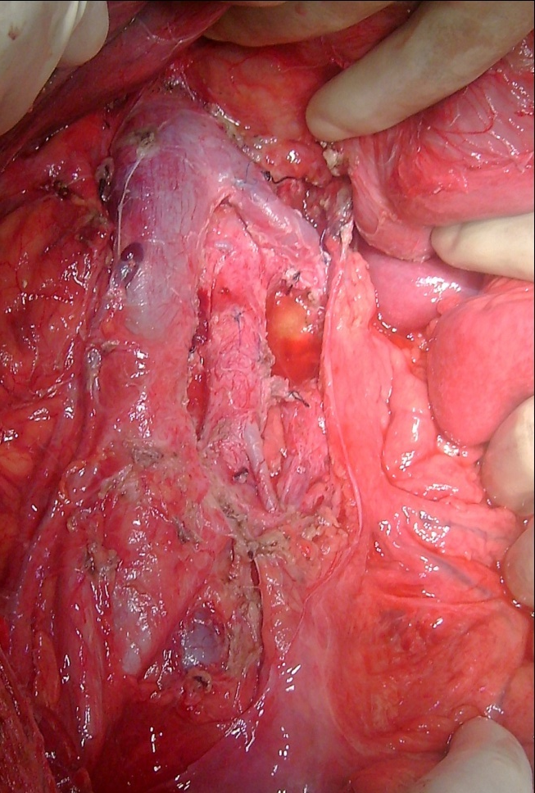
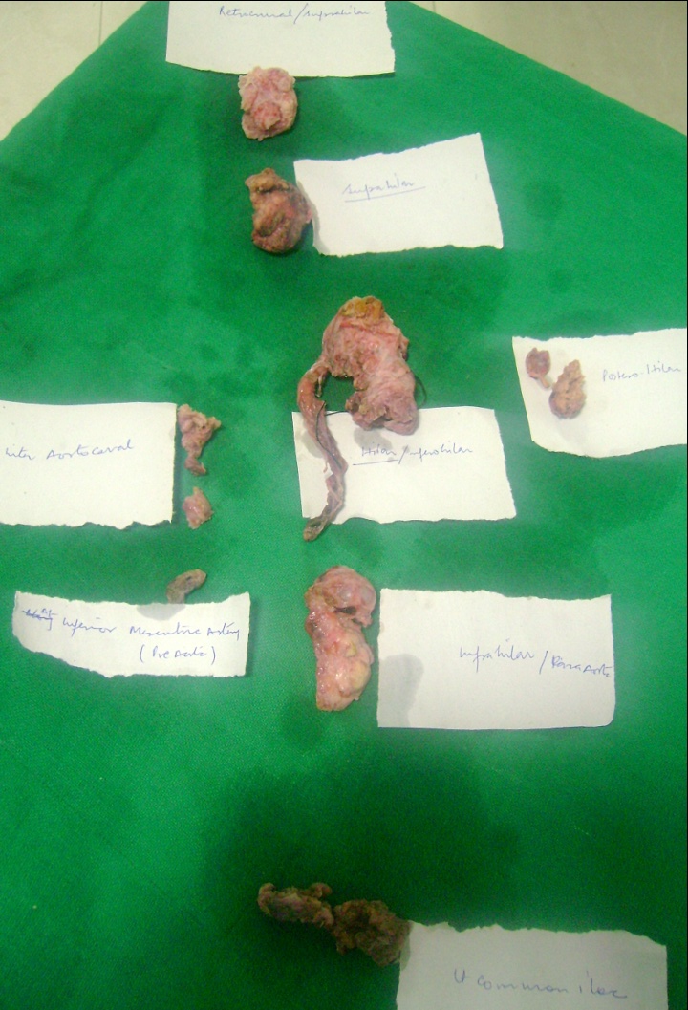

Slide 62
MCQs
Q1. Most common testicular tumor in infants and children is :
Yolk sac tumor
Seminoma
Teratoma
Choriocarcinoma

Slide 63
Q2. Not a risk factor for testicular Tumor :
Contralateral testicular cancer
Family history
Somatosexual ambiguity
Orchitis

Slide 64
Q3. Gold standard for diagnosing Testicular Carcinoma in situ (CIS) :
Testicular USG
Testicular biopsy
Testicular FNAC
Semen analysis

Slide 65
Q4. Tumor marker for pure seminoma is :
beta HCG
Alpha-Feto-Protein
LDH
Placental alkaline phosphatase
None of the above

Slide 66
Q5. “Nerve sparing RPLND” is done to preserve :
1. Erection
2. Ejeculation
3. Urinary continence
4. Fecal continence

Slide 67
Thank You

